Slide 1

T3 Webinars are sponsored by ITS Professional Capacity Building Program, ITS Joint Program Office,
U.S. Department of Transportation
Autonomous Vehicle Assignment and Routing in Congested Networks
Jiangtao Liu (jliu215@asu.edu)
Xuesong Zhou (xzhou74@asu.edu)
School of Sustainable Engineering and the Built Environment
Pitu Mirchandani (pitu@asu.edu)
School of Computing, Informatics, and Decision Systems Engineering (CIDSE)
Arizona State University

Slide 2
Outline
1. Introduction
2. Problem Statement
3. Space-Time-State Network Flow Models
4. Dantzig-Wolfe Decomposition Algorithm
5. Preliminary Experiments
6. Summary

Slide 3


1. Introduction
Ride Sharing Companies
Information-sharing technology

Slide 4
1. Introduction
The “three revolutions” in the future transportation systems

Slide 5
1. Introduction
Future urban transportation systems: integrated multi-modal scheduled transportation system
Picture source: McKinsey&Company, 2016. An integrated perspective on the future of mobility.

Slide 6

1. Introduction
Pickup/drop-off location
Time windows
Origin/destination
Capacity：
Road/transit line/Signal/Depot/Parking
Vehicle-to-passenger assignment
Routing and Congestion
Trip Demand
Vehicle Supply
Infrastructure Design
How to optimize demand, supply and infrastructure?

Slide 7
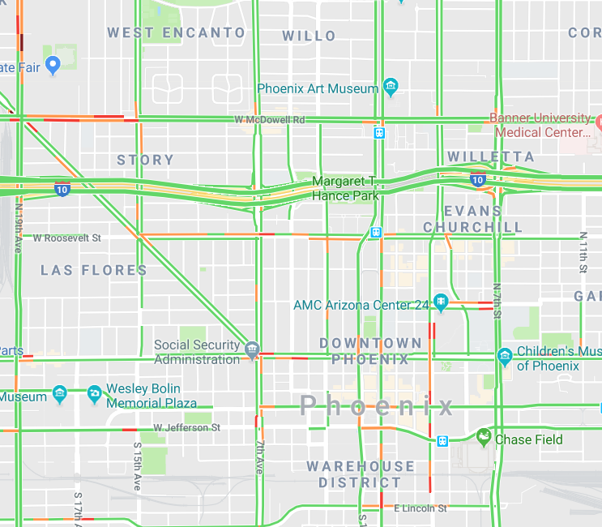
1. Introduction
Key questions:
How many autonomous vehicles do we need?
How many passengers can we serve?
How to capture the new traffic congestion?
What is the best vehicle routing and vehicle-to-passenger assignment solution?

Slide 8
2. Problem Statement
Traffic Assignment Problem:
Network: Physical traffic network
Objective function: System Optimal or User Equilibrium
Road capacity: considered to capture road congestions
Vehicle-to-passenger assignment: given in advance
Passenger trip request: has the same origin and destination as that of the assigned vehicles
Vehicle carrying capacity: not explicitly considered
Variable: usually continuous vehicle flow

Slide 9
2. Problem Statement
Vehicle Routing Problem:
Network: Virtual point-to-point network
Objective function: System Optimal
Traffic congestion: not explicitly considered
Vehicle-to-passenger assignment: will be found
Passenger trip request: has specific pick-up and drop-off location with time windows
Vehicle carrying capacity: considered
Variable: discrete vehicle routing and scheduling

Slide 10
2. Problem Statement
Keywords:
Physical traffic network to consider traffic congestion
Trip requests with Pickup and delivery with time windows
Autonomous vehicles with carrying capacity for ride sharing
Central control (System optimal)

Slide 11
2. Problem Statement
Link Capacity
Without link capacity:
Total cost is 6
With link capacity:
Total cost is 15

Slide 12
2. Problem Statement
System Optimal Coordination
Without coordination (selfish routing):
Total cost is 15
With coordination:
Total cost is 9

Slide 13
2. Problem Statement
Time windows
Total cost is 9
The red vehicle can wait until time 3 to pick up passenger 2, so the blue vehicle can pick up passenger 1 at exact time 3.
The optimal result doesn’t only optimize the vehicle routing, but also the departure time of picked up passengers.

Slide 14
2. Problem Statement
Ridesharing (vehicle carrying capacity)
Total cost is 4
When the red vehicle’s carrying capacity is increased to 2, the total cost is reduced to 4 from 9;
Only the red vehicle is required to serve the trip requests.

Slide 15


2. Problem Statement
The Challenge of solving system optimal vehicle routing with pickup and drop-off location and time windows in congested physical traffic networks:
System-impact of adjusting one vehicle routing:
System marginal vehicle travel cost
System marginal passenger service benefit/cost
[Time window]
[Time window]
In this queuing system:
Waiting time for individual: 4 min
After adding one more person in the queue:
Societal travel time: additional 4 min for each person behind: +16 min, and the waiting time of added person is 4 min, so the system marginal waiting time is 20 min.
Societal service benefit: some persons may not be served in their preferred time window and it decreases the service benefit.

Slide 16
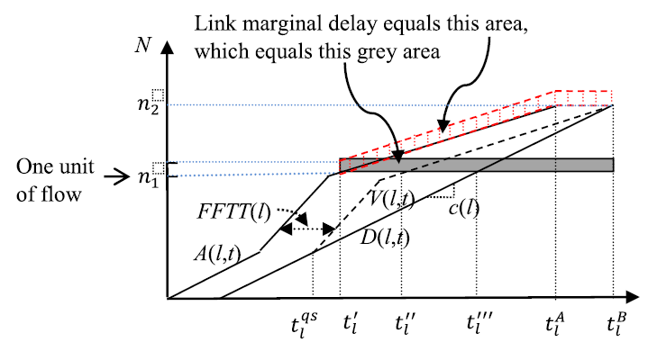
2. Problem Statement
Marginal cost calculation in system optimal dynamic traffic assignment (SODTA)
Ghali and Smith (1995)
Ghali, M.O. and Smith, M.J., 1995. A model for the dynamic system optimum traffic assignment problem. Transportation Research Part B: Methodological, 29(3), pp.155-170.

Slide 17
2. Problem Statement
Our Approach 1: Marginal Cost Calculation
Step 1: Build virtual pickup and drop-off links in physical traffic networks, and its service pricing is converted to generalized link travel cost
Step 2: find one initial solution as the input
Step 3: Perform network loading within a space-time-state network
3.1 use cumulative arrival and departure counts to derive the link marginal travel cost.
3.2 update the marginal service link benefit of passengers (not served or served by multiple vehicles)
Step 4: find the new least-marginal-cost route for each vehicles, and go to step 3; otherwise, stop.

Slide 18
2. Problem Statement
Our Approach 2: Dantzig-Wolfe Decomposition
Restricted master problem
Road capacity constraint
Passenger service constraint
Marginal costs from the solver
Subproblems
(Time-dependent State dependent shortest path problem for each vehicle)
Vehicle routing solution
Solved by the beam-search algorithm in space-time-state networks
Solved by standard solvers

Slide 19
3. Space-time-state network and model formulation
Add virtual pick-up and drop-off nodes and links for each passenger

Slide 20
3. Space-time-state network and model formulation
Time-extended Space-time network construction for physical path $1→2→4→6$
Arc (i,j,t,s) with capacity
Vertex (i,t), (j,s)
Passenger pickup and drop-off time windows and locations are embedded in this network
Space-time network

Slide 21



3. Space-time-state network and model formulation
Challenge: how to model the logit of passenger pickup and delivery with vehicle carrying capacity
One more dimension-> Vehicle Carrying States:
which passengers are being carried by this vehicle:
To record the passenger service status:
0: the passenger is not served;
1: under served (picked up but not delivered);
2: finished (delivered)
Example: In the case: if vehicle capacity is 1 and 2 passengers trip requests,
All possible states: [ ], [1[1]], [1[2]], [2[1]] or [2[2]]

Slide 22

3. Space-time-state network and model formulation
Vehicle carrying state transition logit: focusing on specific passenger 1
0->0: vehicle departs at the origin depot
0->1[1]: passenger 1 is picked up at his location within time window.
1[1]->1[2]: passenger 1 is dropped off at his location within time window
1[2]->0: vehicle arrives at the destination depot.
Once one passenger is picked up, he/she will always be dropped off, because 1[1]->0 is not a feasible state transition.
No passenger will be served if the vehicle carrying capacity is fully used.

Slide 23
3. Space-time-state network and model formulation
Vehicle State Transition with specific locations and time intervals
Vehicle carrying state transition graph

Slide 24
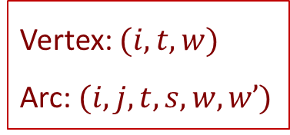
3. Space-time-state network and model formulation
One possible vehicle trajectory in a space-time-state network
state
Vertex: $(i,t,w)$
Arc: $(i,j,t,s,w,w’)$
time
space

Slide 25
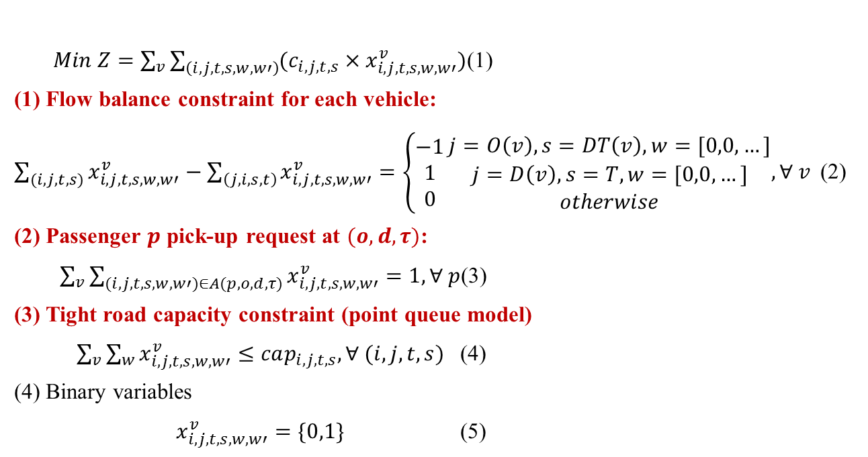
3. Space-time-state network and model formulation
Mathematical formulation:
$Min Z=\sum_{v}{\sum_{\left(i,j,t,s,w,w′\right)}{(c_{i,j,t,s}×x_{i,j,t,s,w,w′}^{v})}}$ (1)
(1) Flow balance constraint for each vehicle:
$\sum_{(i,j,t,s)}{x_{i,j,t,s,w,w′}^{v}}−\sum_{\left(j,i,s,t\right)}{x_{i,j,t,s,w,w′}^{v}}=\left\{\begin{aligned}−1 \\ 1 \\ 0\end{aligned}\right.\begin{matrix}j=O\left(v\right),s=DT\left(v\right),w=[0,0,…] \\ j=D\left(v\right),s=T, w=[0,0,…] \\ otherwise\end{matrix},∀ v$ (2)
(2) Passenger $p$ pick-up request at $(o,d,τ)$:
$\sum_{v}{\sum_{(i,j,t,s,w,w′)∈A(p,o,d,τ)}{x_{i,j,t,s,w,w′}^{v}=1, ∀ p}}$ (3)
(3) Tight road capacity constraint (point queue model)
$\sum_{v}{\sum_{w}{x_{i,j,t,s,w,w′}^{v}}≤cap_{i,j,t,s}, ∀ (i,j,t,s)}$ (4)
(4) Binary variables
$x_{i,j,t,s,w,w′}^{v}=\{0,1\}$ (5)

Slide 26
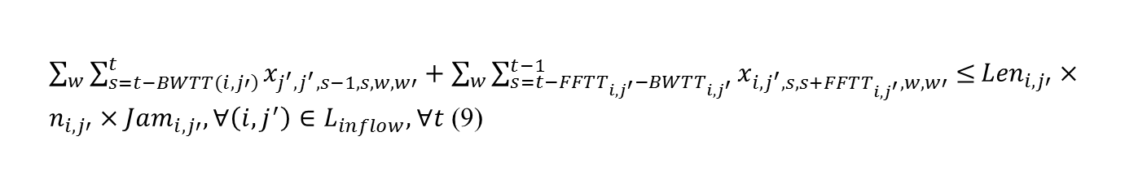
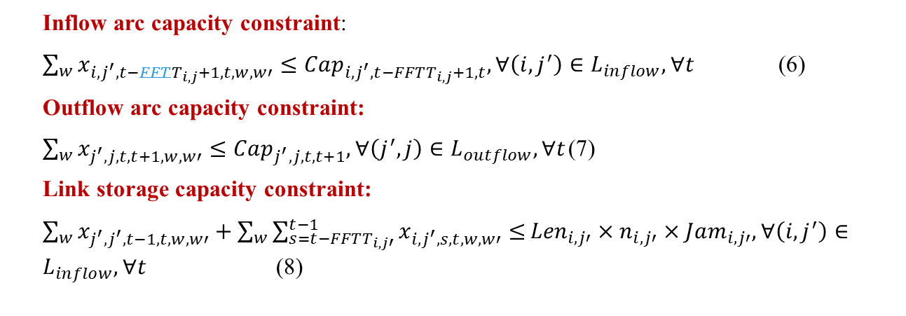
3. Space-time-state network and model formulation
Capture queue spillback:
Inflow arc capacity constraint:
$\sum_{w}{x_{{i,j}^{′},t−FFTT_{i,j}+1,t,w,w′}}≤Cap_{{i,j}^{′},t−FFTT_{i,j}+1,t}, ∀\left(i,j^{′}\right)∈L_{inflow},∀t$ (6)
Outflow arc capacity constraint:
$\sum_{w}{x_{j^{′},j,t,t+1,w,w′}}≤Cap_{j^{′},j,t,t+1}, ∀\left(j^{′},j\right)∈L_{outflow}, ∀t$ (7)
Link storage capacity constraint:
$\sum_{w}{x_{j^{′},j^{′},t−1,t,w,w′}+\sum_{w}{\sum_{s=t−FFTT_{i,j′}}^{t−1}{x_{i,j^{′},s,t,w,w′}≤}}}{Len}_{i,j′}×n_{i,j′}×Jam_{i,j′},∀\left(i,j^{′}\right)∈L_{inflow},∀t$ (8)
Newell’s simplified kinematic wave model (Newell, 1993)
$\sum_{w}{\sum_{\left.s=t−BWTT(i,j′\right)}^{t}{x_{j^{′},j^{′},s−1,s,w,w′}}+\sum_{w}{\sum_{s=t−FFTT_{i,j^{′}}−BWTT_{i,j^{′}}}^{t−1}{x_{i,j^{′},s,s+FFTT_{i,j^{′}},w,w′}≤}}}{Len}_{i,j′}×n_{i,j′}×Jam_{i,j′},∀\left(i,j^{′}\right)∈L_{inflow},∀t$ (9)

Slide 27
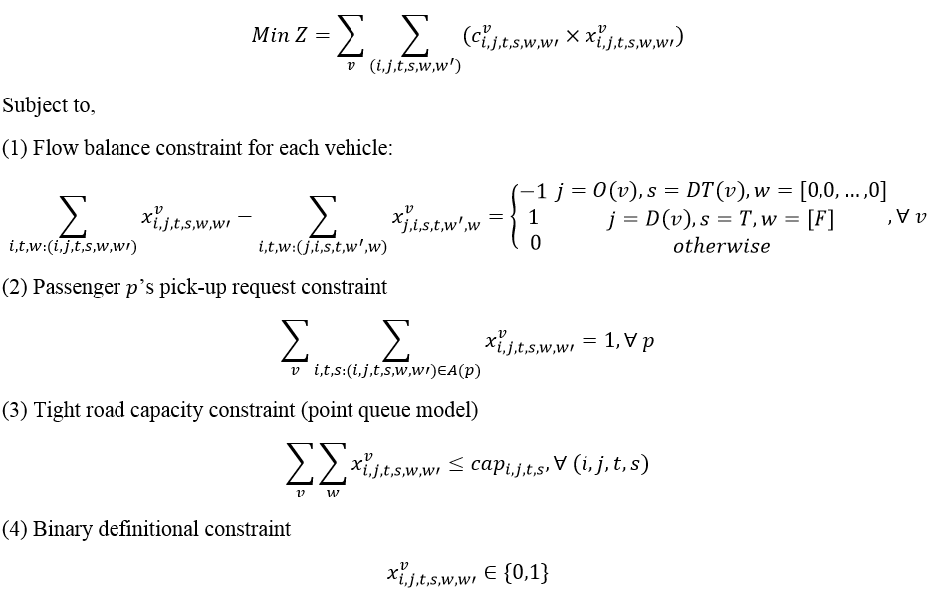
4. Dantzig-Wolfe Decomposition Algorithm
Objective function
Special block: time-dependent state-dependent shortest path problem
A special block can be solved by our VRP solution engine
can be the subproblem in Dantzig-Wolfe decomposition

Slide 28
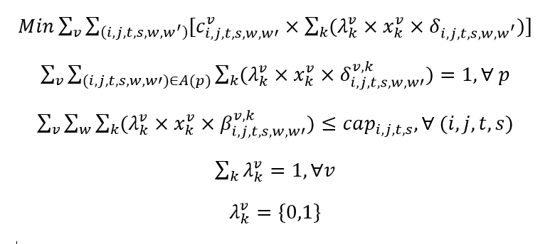
4. Dantzig-Wolfe Decomposition Algorithm
Restricted master problem
Pick-up constraint:
Capacity constraint:
Column selection:

Slide 29
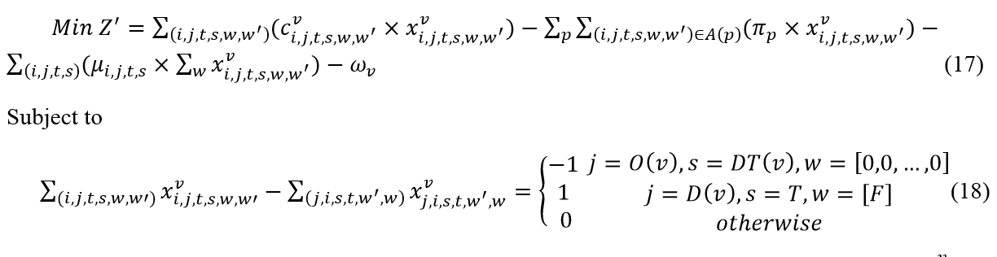
4. Dantzig-Wolfe Decomposition Algorithm
Subproblems (TDSDSP)
Dual variable/ marginal cost of passenger pickup constraints
Dual variable/ marginal cost of congestion constraints
Dual variable/ marginal cost of path weight constraints

Slide 30
4. Dantzig-Wolfe Decomposition Algorithm

Slide 31
4. Dantzig-Wolfe Decomposition Algorithm
A tree-based path representation
One-to-all shortest path tree is generated for one vehicle
Directly obtain the shortest path for vehicles with a same depot and departure time but different destination depot
Does not need to run the shortest path algorithm again to improve the computation efficiency.
A tree-based path representation

Slide 32
5. Preliminary Experiments
# of nodes | 24
# of links | 84
# of trip requests (pickup and drop-off with time windows) | 30
# of available autonomous vehicles | 30
# of depots | 5
optimization time horizon (time unit) | 110
Vehicle capacity (person) | 1
Sioux Falls Network

Slide 33
5. Preliminary Experiments
Initial feasible solution
Vehicle_No | Passenger_No | Vehicle_No | Passenger_No | Vehicle_No | Passenger_No
1 | [15] | 11 | [20] | 21 | [23]
2 | [8] | 12 | [26] | 22 | [25]
3 | [1] | 13 | [16] | 23 | [22]
4 | [7] | 14 | [18] | 24 | [19]
5 | [9] | 15 | [2] | 25 | [4]
6 | [11] | 16 | [10] | 26 | [5]
7 | [29] | 17 | [3] | 27 | [24]
8 | [28] | 18 | [12] | 28 | [14]
9 | [17] | 19 | [27] | 29 | [13]
10 | [21] | 20 | [30] | 30 | [6]

Slide 34
5. Preliminary Experiments
Dantzig-Wolfe decomposition algorithm solution:
Each passenger has specific pickup and drop-off location and time windows
The vehicle benefit of serving one passenger is 20
The vehicle waiting cost is the half of the waiting time
 | Number of required vehicles | Total travel cost
Initial solution | 30 | 1096
vehicle carrying capacity is 1 | 27 | 967.5
vehicle carrying capacity is 2 | 25 | 869.5
Take vehicle 9 as an example:
In initial solution: picks up passenger 17 -> drops off passenger 17;
Vehicle carrying capacity is 1: picks up passenger 17 -> drops off passenger 17-> picks up passenger 29 -> drops off passenger 29
Vehicle carrying capacity is 2: picks up passenger 17 -> drops off passenger 17-> picks up passenger 30-> picks up passenger 29-> drops off passenger 29-> drops off passenger 30

Slide 35
6. Summary
Our goals:
Minimize the system-level travel cost, including vehicle travel time and service benefits
Satisfy passengers’ trip requests with pickup and drop-off location and time windows
Consider the road congestion incurred by assigned vehicles
Future Extension: multi-modal scheduled transportation system: human-driven vehicles, autonomous vehicles, and public transit systems.

Slide 36
6. Summary
Required knowledge:
Dynamic Traffic Assignment and Vehicle Routing Problem
Space-time-state network construction and network flow model
Time-dependent State-dependent shortest path problem
Dantzig-Wolfe decomposition algorithm

Slide 37
References
Space-time-state network flow models and vehicle routing problem:
1. Mahmoudi, M. and Zhou, X., 2016. Finding optimal solutions for vehicle routing problem with pickup and delivery services with time windows: A dynamic programming approach based on state–space–time network representations. Transportation Research Part B: Methodological, 89, 19-42.
2. Liu, J., Kang, J., Zhou, X., Pendyala, R., 2018. Network-oriented household activity pattern problem for system optimization. Transportation Research Part C 94, 250-269
3. Zhou, X., Tong, L., Mahmoudi, M., Zhuge, L., Yao, Y., Zhang, Y., Shang, P., Liu, J. and Shi, T., 2018. Open-source VRPLite Package for Vehicle Routing with Pickup and Delivery: A Path Finding Engine for Scheduled Transportation Systems. Urban Rail Transit, 4(2), 68-85.
Dynamic Traffic Assignment and Traffic flow model:
4. Lu, C.C., Liu, J., Qu, Y., Peeta, S., Rouphail, N.M. and Zhou, X., 2016. Eco-system optimal time-dependent flow assignment in a congested network. Transportation Research Part B: Methodological, 94, pp.217-239.
5. Zhou, X. and Taylor, J., 2014. DTALite: A queue-based mesoscopic traffic simulator for fast model evaluation and calibration. Cogent Engineering, 1(1), p.961345.
Dantzig-Wolfe Decomposition algorithm
6. https://en.wikipedia.org/wiki/Dantzig%E2%80%93Wolfe_decomposition

Slide 38


